Slide 1
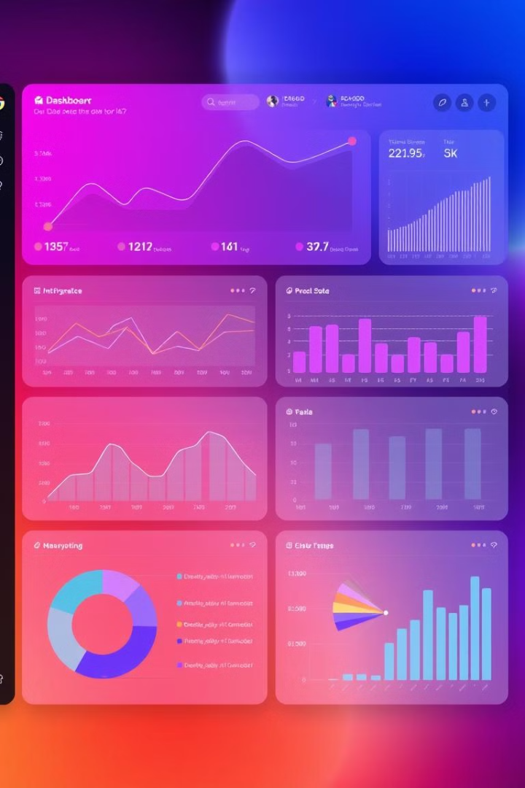
Power BI Dashboard: Unlocking Business Insights
Power BI dashboards empower businesses to glean actionable insights from their data. These dynamic dashboards offer a powerful platform for data exploration, visualization, and communication.

Slide 2

Introduction to Power BI Dashboards
Data Visualization
Real-time Insights
Power BI dashboards transform raw data into interactive and compelling visuals, making complex information accessible to everyone.
Dashboards provide real-time updates, allowing users to track key performance indicators (KPIs) and monitor progress over time.
Personalized Experience
Users can customize dashboards to their specific needs, focusing on relevant data and tailoring visualizations to their preferences.

Slide 3

Connecting Data Sources
1
Excel Spreadsheets
Power BI seamlessly integrates with Excel, enabling users to analyze and visualize data from their existing spreadsheets.
2
SQL Databases
Connect to relational databases, such as SQL Server, to access structured data and perform powerful analytics.
3
Cloud-Based Services
Power BI integrates with various cloud services, including Azure, Google Cloud Platform, and Amazon Web Services.

Slide 4
Creating Visuals and Visualizations
Charts and Graphs
Maps and Geospatial Data
Custom Visualizations
Bar charts
Power BI maps allow users to visualize data geographically, pinpointing trends and patterns.
Expand the capabilities of Power BI with custom visuals, created by the Power BI community or third-party developers.
Line charts
Pie charts
Scatter plots

Slide 5




Customizing the Dashboard Layout
Grid Layout
Organize visualizations using a grid system, ensuring a clean and structured layout.
Interactive Elements
Include interactive elements, such as slicers and filters, to allow users to explore data dynamically.
Branding and Aesthetics
Customize the dashboard's look and feel with your company's branding, colors, and fonts.

Slide 6




Sharing and Collaborating on Dashboards
Share with Colleagues
Collaborate on Insights
Publish to the Web
Share dashboards with colleagues within your organization, allowing them to access and analyze data.
Collaborate with colleagues, providing feedback, discussing insights, and refining the dashboard based on input.
Publish dashboards to the web, making them accessible to a wider audience, including external stakeholders.

Slide 7
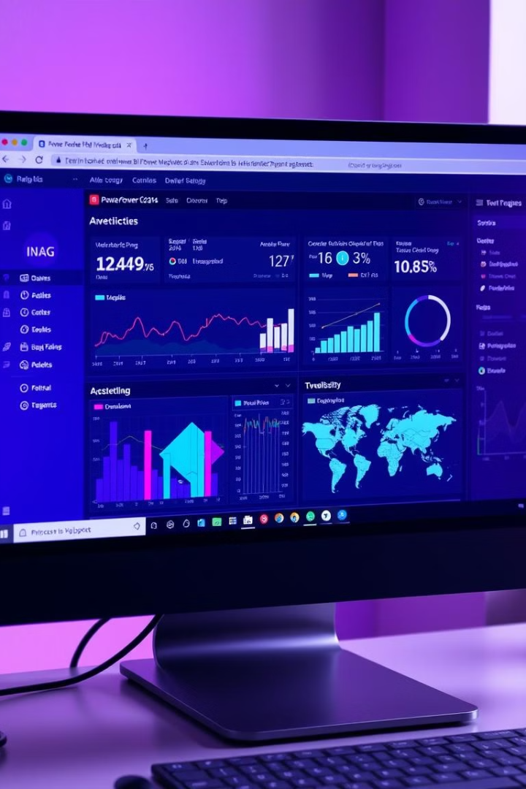
Integrating Dashboards with Other Applications
1
Web Applications
2
Microsoft Teams
Embed Power BI dashboards directly into websites and web applications, providing a seamless experience for users.
Integrate dashboards into Microsoft Teams, making data readily available during team meetings and collaborations.
3
Other Business Tools
Connect Power BI dashboards to other business applications, such as CRM and ERP systems, to gain a unified view of your data.

Slide 8

Dashboard Maintenance and Optimization
Data Refresh
Ensure data is updated regularly, reflecting the latest information and trends.
Performance Optimization
Monitor dashboard performance, addressing any bottlenecks or slow loading times.
User Feedback
Gather user feedback to identify areas for improvement and ensure the dashboard meets the needs of its audience.

Slide 9

Conclusion: The Power of Power BI Dashboards
Power BI dashboards empower businesses to make data-driven decisions, driving growth and efficiency. By leveraging the
power of data visualization and analysis, organizations can unlock valuable insights and gain a competitive edge.

